Slide 1
Branching, while, CLI
if statements, Loops, and Commandline Interface

Slide 2
Lesson #3 Learning Outcomes
Boolean datatype
Relational operators
if statements (if, elif, else)
Logical operators
Boolean expressions
Indefinite iteration (while loops)
Command Line Interface (CLI)

Slide 3
Boolean
So far we have worked with int, float and string data types.
Boolean is a data type that has two values: True and False.
The uppercase first letters are important.
Boolean variables can hold either True or False values (these are boolean values, not Strings).
Boolean variables can be used as flags
A flag is a variable that signals when some condition is met.

Slide 4
Relational Operators
Relational operators are used to compare between values and evaluate to True or False.
Relational operators can be used to compare numbers or strings.
Relational Operator | Description | Example (a = 3 , b = 4 )
< | a < b means a is less than b | a < b ➔ True a < 2 ➔ False
> | a > b means a is greater than b | b > a ➔ True a > b ➔ False
<= | a <= b means a is less than or equal to b | a <= b ➔ True a <= 3 ➔ True a <= 2 ➔ False
>= | a >= b means a is greater than or equal to b | b >= a ➔ True b >= 4 ➔ True b >= 5 ➔ False
== | a == b means a is equal to b | a == 3 ➔ True a == b ➔ False
!= | a != b means a is not equal to b | a != b ➔ True a != 3 ➔False

Slide 5
Relational Operators
Note that = and == are different symbols
= is an assignment operator; assign the value on the right to the variable on the left
== is equality comparison operator that evaluates to True or False
number = 5 assigns the value 5 to the variable number
number == 5 True or False; does variable number have the value 5?
Truthy/Falsy:
https://www.freecodecamp.org/news/truthy-and-falsy-values-in-python/

Slide 6
if Statement
So far we have seen sequential execution of the statements.
Statements are executed one after the other in the order in which they appear:
a()
b()
c()
Sometimes the behaviour of program needs to change depending on a certain condition.
If statements are used to check conditions and change the behaviour of the program accordingly; they can be used to skip code sections, or to select one section out of many:
a()
if something is True:
b() # b may or may not be executed
c()

Slide 7
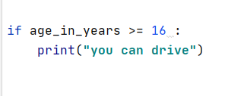
if statement
General syntax:
if Boolean expression:
statement
statement
etc.
The statements will execute ONLY IF the result of the Boolean expression is True.
The indentation is important.

Slide 8
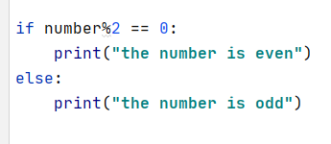
else Statement
“if” may also be paired with “else”:
Do one path if the statement is True;
Do the other path if the statement is False.
General Syntax:
if Boolean expression :
statements which run when “if” is True
else:
statements which run when “if” is False

Slide 9
else Statement
first_name = "jason"
age_in_years = 12
if age_in_years >= 16:
print("you are old enough to drive")
print("be safe")
print("have fun")
print("don't speed")
else:
print("you are not old enough to drive")
print("you have to wait", 16 - age_in_years, "more years", first_name, "!!!")

Slide 10
else Statement
When you write an if-else statement, follow these guidelines for indentation:
Make sure the if block and the else block are aligned (same level of indentation).
The if block and the else block are each followed by a colon and then an intended block of statements.
Make sure the statements inside each block are consistently indented (eg 4 spaces).
See the next slide…

Slide 11
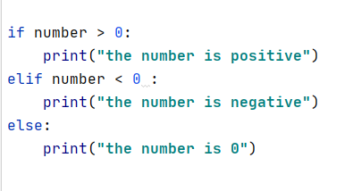
Chained conditionals (if / elif / else)
Sometimes there are more than two possibilities, so we need even more than two branches.
Example:

Slide 12
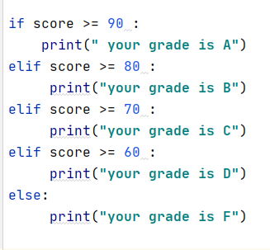
Chained conditionals (if / elif / else)
first_name = "jason"
age_in_years = 16
if age_in_years > 16:
print("you are old enough to drive")
print("be safe")
print("have fun")
print("don't speed")
elif age_in_years == 16:
print("you are barely old enough to drive")
print("go take some lessons")
else:
print("you are not old enough to drive")
print("you have to wait", 16 - age_in_years, "more years", first_name, "!!!")

Slide 13
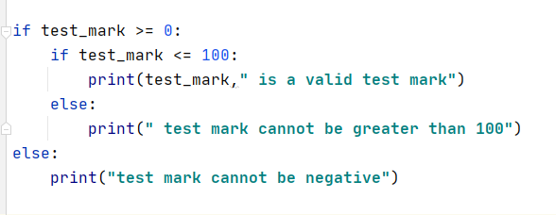
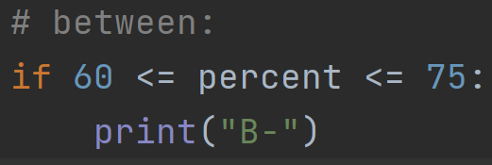
Nested if statements
if statements can be nested, to implement more complex logic
Example: To validate that a test mark is between 0 and 100 inclusive:
But do not indent too many times. That code is too complex to follow.

Slide 14
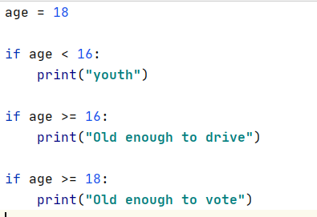
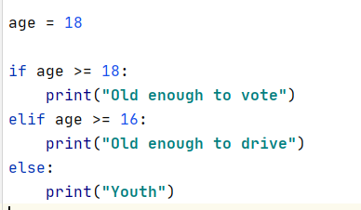
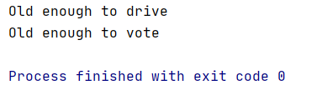

Distinct if Statements
Example:
On the left, all three if blocks are evaluated, always
On the right, either one, two, or three blocks are executed.

Slide 15
Logical Operators
Python’s three logical operators are and, or, not
Boolean operators can be used to create complex Boolean expressions.
Assuming that P and Q are two Boolean variables
P | Q | P and Q | P or Q | not P
False | False | False | False | True
False | True | False | True | True
True | False | False | True | False
True | True | True | True | False

Slide 16
Logical Operators: and, or, not
Boolean Operator | Description | Example
and | AND: True when and only when both operands are True. | 3 == 3 and 2 == 2 is True 3 == 8 and 2 == 3 is False
or | OR: False when and only when both operands are False. | 3 == 3 or 2 == 3 is True 3 == 2 or 2 == 2 is True 3 == 1 or 2 == 1 is False
not | NOT (opposite): True when the single operand is False (and False when operand is True).​ | not (3 == 3) is False not (2 == 3) is True

Slide 17
Logical Expressions – Order of Operations
Precedence Rules: the order in which operators are evaluated in expressions.
Operator/Convention | Description
( ) | Items within parentheses are evaluated first
* / % + - | Arithmetic operators (using their precedence rules; see earlier section)
< <= > >= == != | Relational, inequality, and membership operators
not | logical NOT
and | Logical AND
or | Logical OR

Slide 18
Short-Circuit Evaluation
Python evaluates if statements from left to right.
Sometimes evaluating the left part is sufficient to determine the end result therefore the right part will not be evaluated.
This is called Short-Circuit Evaluation.

Slide 19
Short-Circuit Evaluation: and
Example:
if 5 > 10 and 7 > 0 :
The first(left) part of the if statement results in False therefore, the second part will not be evaluated because
False and anything results in False
After seeing only the left-hand expression, Python knows this and statement will be False.

Slide 20
Short-Circuit Evaluation: or
Similarly,
if 5 < 10 or 7 < 0:
the first(left) part of the if statement expression results in True therefore, the second part will not be evaluated because
True or anything evaluates to True.
if 7 < 0 or 5 < 10:
Both expressions must be evaluated.

Slide 21
Repetition Statements: while loop
if conditional statement is True:
do this
do that
do this too
while conditional statement is True:
do this
do that
do this too
A while loop is a self-repeating if statement

Slide 22
Repetition Statements: while loop
A block of code inside an “if statement” gets executed zero times, or one time.
A block of code inside a “while statement” gets executed zero times, one time, … 500 times, … infinity times. It depends on the logic.

Slide 23
Repetition Statements: while loop
The condition is given before the loop body.
The condition is checked before each execution of the loop body; it is like a self-repeating if statement.
Often, the while loop is used when it is impossible to determine the exact number of loop iterations in advance.
General Syntax:
while <condition>:
block of code

Slide 24
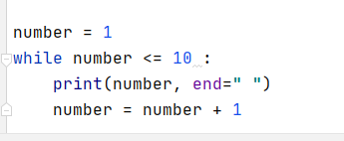

Repetition Statements: while loop
Example: to display the numbers from 1 to 10:
Output:

Slide 25
Repetition Statements: while loop
# print the even numbers from 1 to 100
i = 1
while i <= 100:
if i % 2 == 0:
print(i)
i += 1 # or i = i + 1

Slide 26
Infinite Loop
An infinite loop occurs when a program keeps executing within one loop, never leaving it.
This happens if the condition will never be False.
Example:
number = 1
while number <= 10:
print(number)

Slide 27
Stopping Code
The while loop condition should eventually evaluate to False.
We can use a break statement to terminate the loop; the flow of control will jump to the statement directly after the while loop.
Use exit() to terminate the program (note: this is rarely used).
Use return to exit from a function.
Use continue to skip the rest of the current iteration of a while loop.

Slide 28
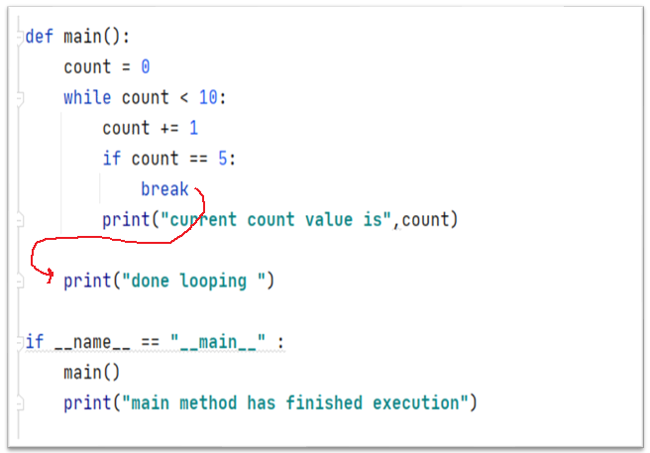
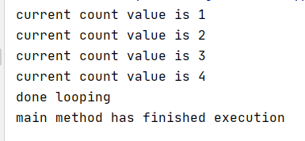
Stopping a while Loop
Example of using break statement to stop the loop before printing 5:
Output:

Slide 29
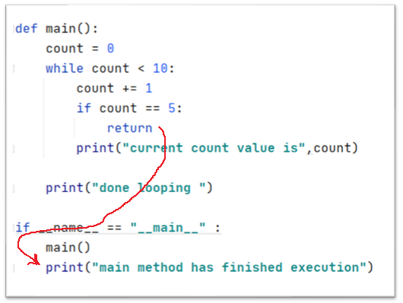
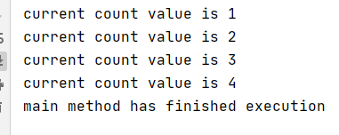
Stopping a while Loop
Example of using return statement (inside a function), which stops the entire function running:
Output:

Slide 30
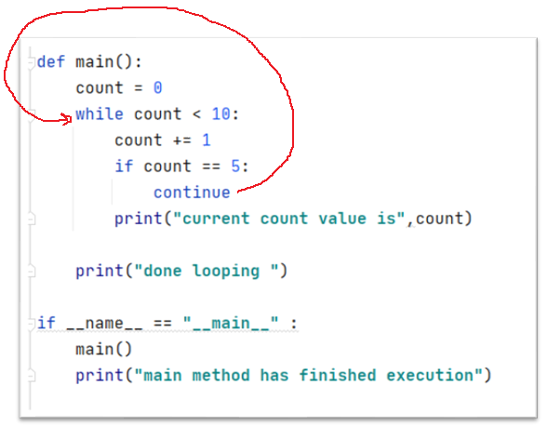
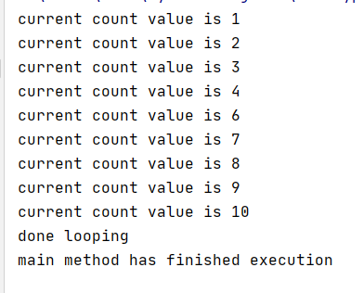
Stopping a while loop
Example of using continue statement to stop the rest of the current iteration, and ask if the loop should continue or not:
Output:

Slide 31
CLI Command Line Interface
A Python program is run from the command-line (i.e., the Windows or Linux command prompt or terminal)
In PyCharm, we have three options to run our programs
PyCharm Console (preferred)
Python Console using runfile () command
Terminal using python command

Slide 32
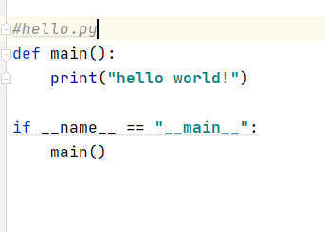
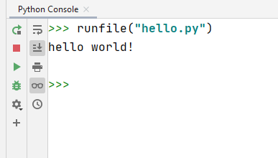
CLI Command Line Interface
Example of running a program from Python console using runfile()
Given the following python script
Running the script from Python console:

Slide 33
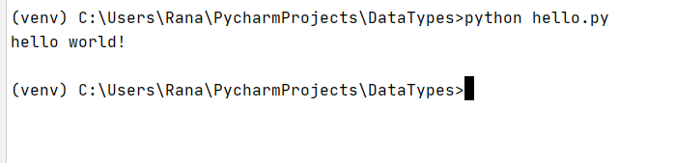
CLI Command Line Interface
Example of running a script from Windows Command Prompt using command python
Given the following python script
Running the script from Windows command Prompt:

Slide 34
CLI Command Line Interface
For a “production” Python program, it would be run from a Windows Command Prompt or Linux Terminal.
For our development, we will use the PyCharm console.

